Slide 1




NEXT GEN EMPLOYABILITY PROGRAM
Creating a future-ready workforce
Team Members
College Name
Student Name :PRASANNARAGAVENDRAN G
Student ID :au622021104083
PAAVAI COLLEGE OF ENGINEERING

Slide 2

CAPSTONE PROJECT SHOWCASE
Project Title
Building Bus Reservation System using Python and Django
Abstract | Problem Statement | Project Overview | Proposed Solution | Technology Used | Modelling & Results | Conclusion

Slide 3
Abstract
The Bus Reservation System is a comprehensive software solution designed to streamline the process of booking bus tickets for passengers while providing efficient management tools for bus operators. This project aims to develop a web-based application using Python and Django framework, offering users a seamless experience for reserving bus seats, managing bookings, and accessing relevant information.
Key Features:
1.*User Registration and Authentication*: The system will allow users to create accounts, log in securely, and manage their profiles.
2. *Bus Route Management*: Admins can add, edit, and delete bus routes, including details such as origin, destination, stops, and timings.
3. *Seat Selection*: Passengers can view available seats on different buses and select their preferred seats based on availability.
4. *Booking Management*: Users can search for buses based on various criteria like date, time, route, and seat availability. They can book tickets, view booking history, and cancel bookings if needed.
5. *Payment Integration*: Integration with payment gateways to facilitate secure online payments for ticket bookings.
6. *Admin Panel*: A comprehensive admin dashboard to manage buses, routes, bookings, users, and generate reports.
7. *Email Notifications*: Automated email notifications for booking confirmation, ticket cancellation, and other relevant updates.
Source :

Slide 4
Problem Statement
The existing bus reservation systems often lack efficiency and user-friendliness, leading to inconvenience for both passengers and bus operators. Manual booking processes, limited accessibility, and lack of real-time updates are some of the common issues faced by users. Therefore, there is a need for a modern, automated Bus Reservation System to streamline the booking process, enhance user experience, and improve operational efficiency for bus operators.
Key Challenges:
*Manual Booking Processes: Many bus operators still rely on manual booking processes, leading to errors, inefficiencies, and delays in ticket reservations.
Limited Accessibility: Existing reservation systems may not be easily accessible to users, especially those in remote areas, resulting in difficulty in booking tickets.
Real-Time Updates: Passengers often face challenges in obtaining real-time updates on bus schedules, availability of seats, and other relevant information.
Inefficient Management: Bus operators struggle with managing routes, schedules, seat allocations, and booking records efficiently, leading to operational challenges.
Security Concerns: Security of user data and payment transactions is crucial but may not be adequately addressed in some existing systems, posing a risk to users' privacy and financial information.
Source :

Slide 5
Project Overview
The Bus Reservation System project aims to develop a web-based application using Python and Django framework, providing a seamless platform for passengers to book bus tickets and for bus operators to manage their fleet and bookings efficiently. This project will encompass various modules and functionalities to cater to the needs of both users and administrators.
Key Features:
User Registration and Authentication: Users will be able to register for accounts securely and log in using authentication mechanisms. This will allow them to access personalized features such as booking history and profile management.
Bus Management: Administrators will have the capability to manage buses, including adding new buses, updating existing bus details such as routes, schedules, and seating capacities, and removing buses from service if necessary.
Route Management: The system will support the management of bus routes, enabling administrators to add new routes, update route details, and deactivate routes as needed.
Seat Selection and Booking: Passengers will be able to search for available buses based on their desired route and date, view seat availability, select seats, and proceed to book tickets. They will receive confirmation of their booking via email or SMS.
Source :

Slide 6


Technology Used
Front-end
Back-end
Source :

Slide 7
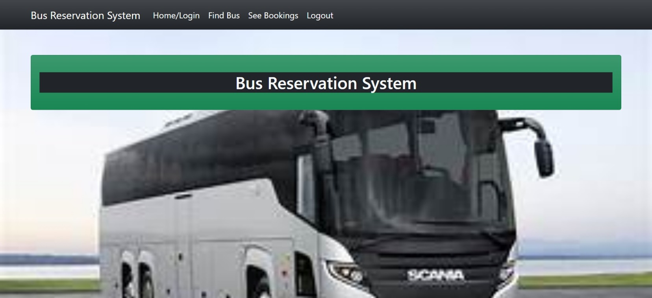
Homepage

Slide 8
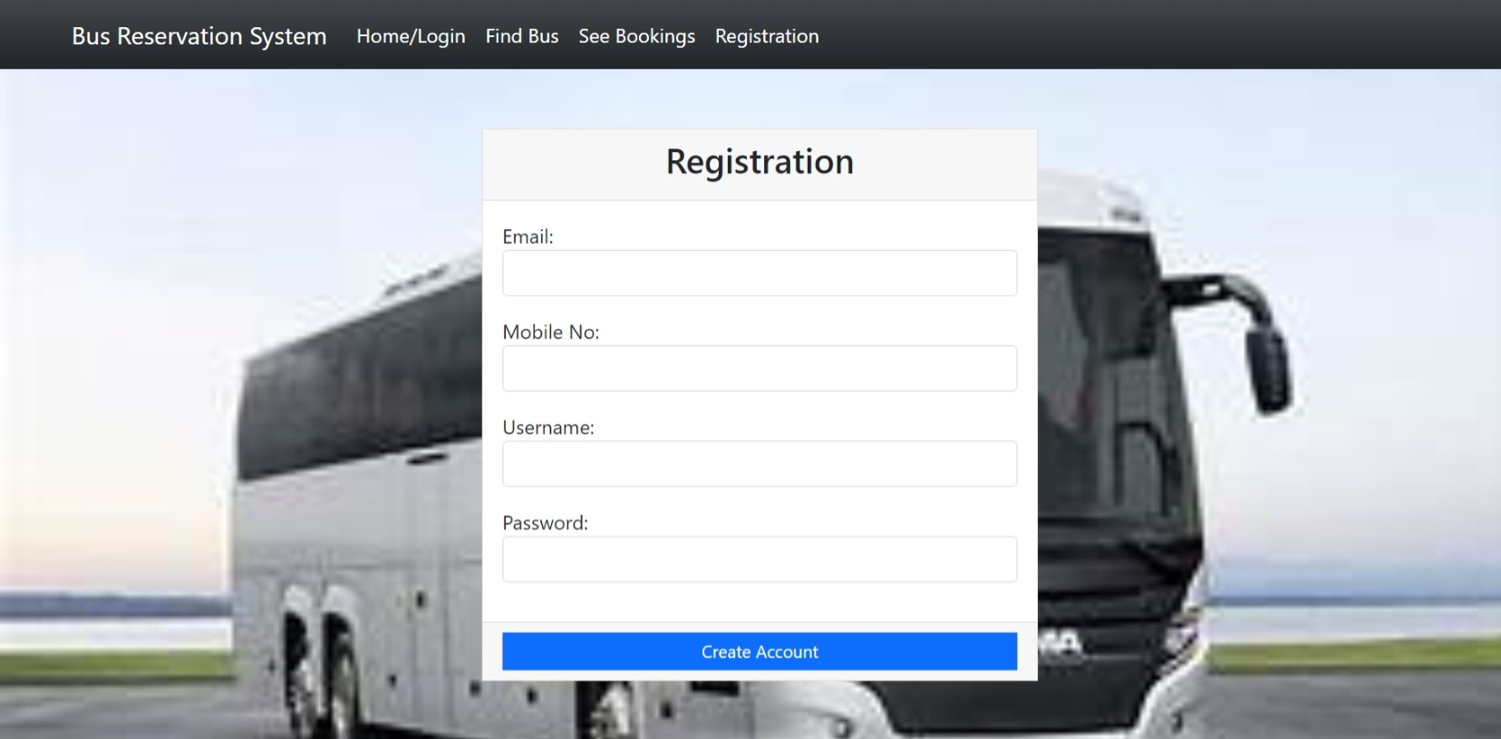
REGISTER PAGE

Slide 9
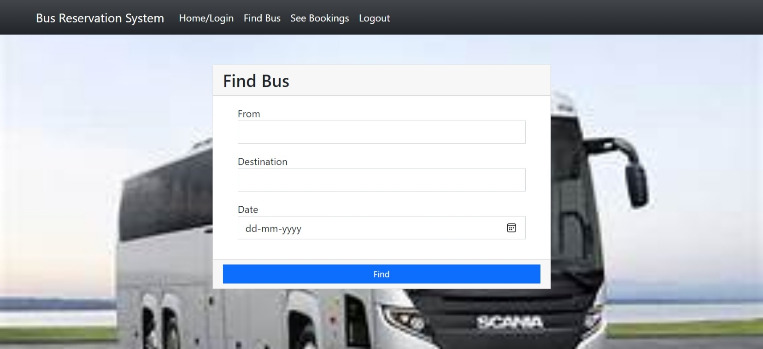
FIND BUS

Slide 10
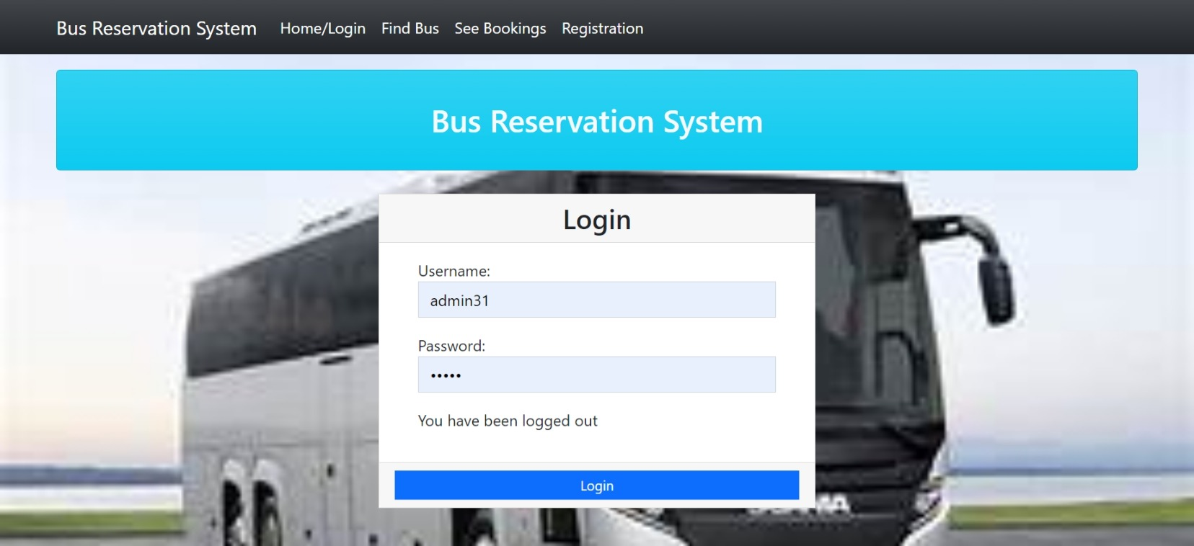
LOGIN PAGE

Slide 11
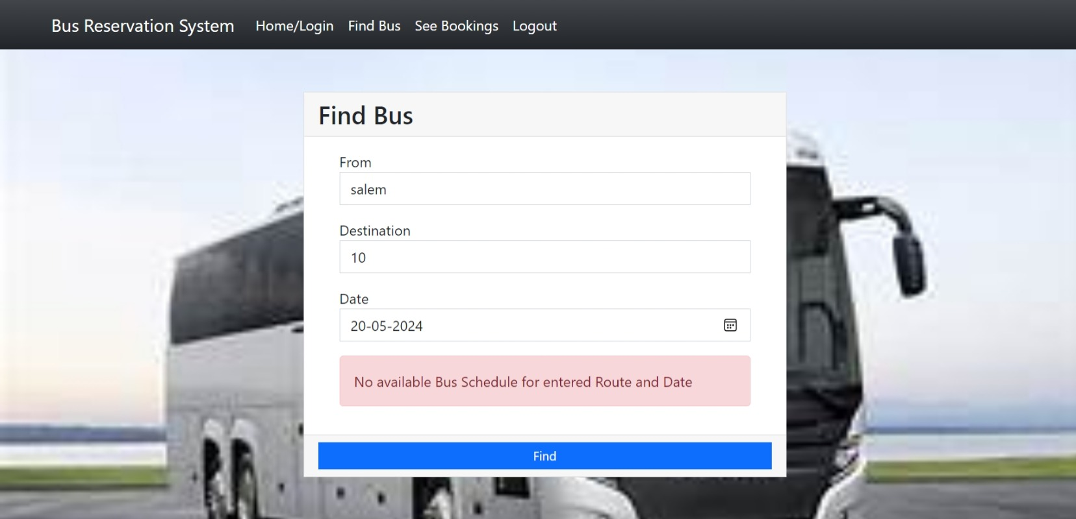
LIST OF BOOKING

Slide 12
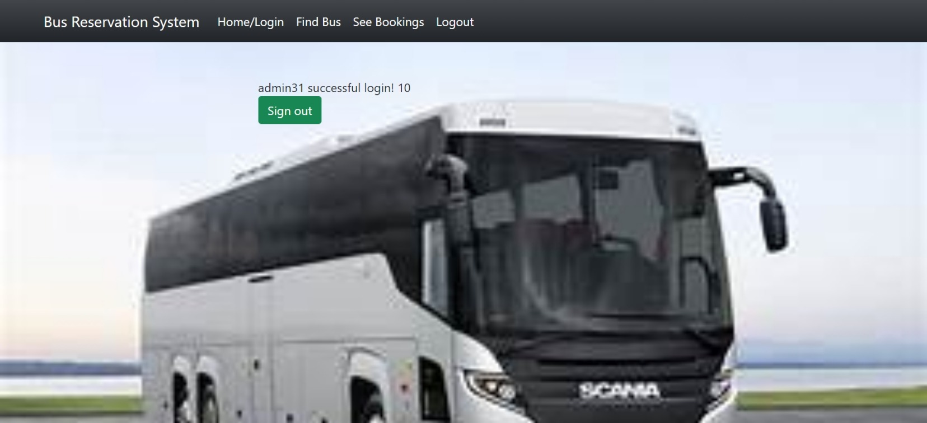
LOGOUT PAGE

Slide 13
Future Enhancements:
After building the initial version of the bus reservation system using Python and Django, there are several future enhancements and features that could be considered to improve its functionality, user experience, and competitiveness in the market:
Real-Time Bus Tracking: Implement a feature that allows passengers to track the real-time location of buses on their scheduled routes. Integration with GPS or location-based services can provide accurate bus tracking information to users.
Dynamic Pricing and Discounts: Introduce dynamic pricing based on factors such as demand, time of booking, and seat availability. Additionally, offer discounts, promotional codes, and loyalty rewards to encourage repeat bookings and attract more customers.
Mobile Application Development: Develop native mobile applications for iOS and Android platforms to provide a seamless booking experience to users on their smartphones and tablets. Mobile apps can offer push notifications, in-app payments, and offline access features.
Feedback and Rating System: Implement a feedback and rating system that allows passengers to provide feedback on their travel experience and rate the service. This can help improve service quality and address any issues promptly.
Multi-Language Support: Offer support for multiple languages to cater to a diverse user base. Allow users to switch between languages based on their preferences, making the platform more accessible to international users.

Slide 14
Conclusion
The Bus Reservation System project aims to revolutionize the bus booking experience by providing a user-friendly, efficient, and secure platform for passengers and bus operators. By leveraging the power of Python and Django, along with modern web development technologies, the system will streamline the booking process, enhance customer satisfaction, and optimize operational efficiency for bus operators.
Source :

Slide 15
Thank You!
Notes:
Thank You !!

